Slide 1
HTML5

Slide 2
Content
Introduction
HTML Page Structure
HTML Editors
HTML Basic Elements

Slide 3
What is HTML?
HTML stands for Hyper Text Markup Language
HTML is the standard markup language for creating Web pages
HTML describes the structure of a Web page
HTML consists of a series of elements
HTML elements tell the browser how to display the content
HTML elements label pieces of content such as "this is a heading", "this is a paragraph", "this is a link", etc.

Slide 4
Example
<!DOCTYPE html>: declaration defines that this document is an HTML5 document
<html>: element is the root element of an HTML page
<head>: element contains meta information about the HTML page
<title> element specifies a title for the HTML page (which is shown in the browser's title bar or in the page's tab)
<body> element defines the document's body, and is a container for all the visible contents, such as headings, paragraphs, images, hyperlinks, tables, lists, etc.
<h1> element defines a large heading
<p> element defines a paragraph
<!DOCTYPE html> <html> <head> <title>Page Title</title> </head> <body> <h1>My First Heading</h1> <p>My first paragraph.</p> </body> </html>

Slide 5
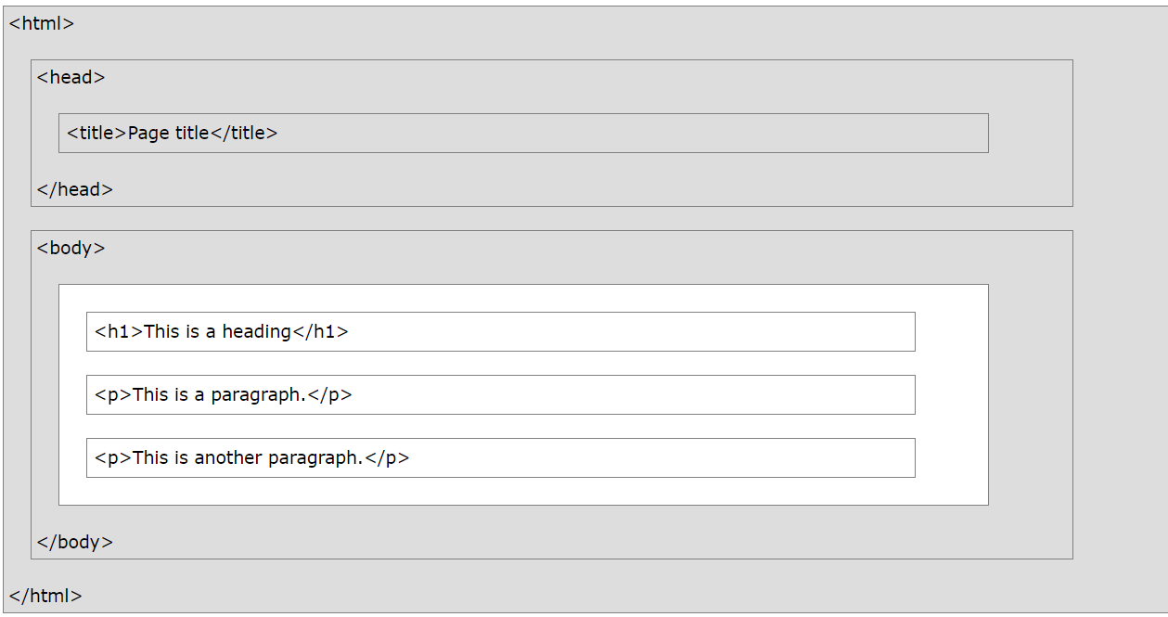
HTML Page Structure

Slide 6
HTML Basics
HTML Documents
All HTML documents must start with a document type declaration: <!DOCTYPE html>.
The HTML document itself begins with <html> and ends with </html>.
The visible part of the HTML document is between <body> and </body>
The <!DOCTYPE> Declaration
The <!DOCTYPE> declaration represents the document type, and helps browsers to display web pages correctly.
It must only appear once, at the top of the page (before any HTML tags).
The <!DOCTYPE> declaration is not case sensitive.

Slide 7
How To View HTML Source?
View HTML Source Code:
Right-click in an HTML page and select "View Page Source" (in Chrome) or "View Source" (in Edge), or similar in other browsers.
This will open a window containing the HTML source code of the page.
Inspect an HTML Element:
Right-click on an element (or a blank area), and choose "Inspect" or "Inspect Element" to see what elements are made up of (you will see both the HTML and the CSS).
You can also edit the HTML or CSS on-the-fly in the Elements or Styles panel that opens.

Slide 8
HTML Editors
A simple text editor can be used to write html code
Web pages can be created and modified by using professional HTML editors.
Steps to create web page using notepad
Open any text editor
Write HTML code
Save the HTML file with .htm extension and preferable encoding is UTF – 8
View the HTML page in the browser

Slide 9
Fundamental Syntax And Semantics

Slide 10
What is an HTML Element?
An HTML element is defined by a start tag, some content, and an end tag:
<tagname> Content goes here... </tagname>
The HTML element is everything from the start tag to the end tag:
<h1> My First Heading </h1>
<p> My first paragraph. </p>
Start Tag | Element content | End Tag
<h1> | My First Heading | </h1>
<p> | My First Paragraph | </p>
<br> | None | none

Slide 11
Nested HTML ELEMENT
<!DOCTYPE html> <html> <head> <title>Page Title</title> </head> <body> <h1>My First Heading</h1> <p>My first paragraph.</p> </body> </html>
HTML elements can be nested
It means that elements can contain other elements
All HTML documents consist of nested HTML elements.

Slide 12
HTML Element
Few Tips:
Never skip end tag
Document may be displayed incorrectly
HTML is not case sensitive
Empty HTML elements
<br> tag is without end tag: Used to break the line

Slide 13
HTML Attributes
All HTML elements can have attributes
Attributes provide additional information about elements
Attributes are always specified in the start tag
Attributes usually come in name/value pairs like: name="value"

Slide 14
HTML Attributes
<!DOCTYPE html> <html> <head> <title>Page Title</title> </head> <body> <h1>My First Heading</h1>
<a href="https://www.w3schools.com">Visit W3Schools</a>
<p>My first paragraph.</p> </body> </html>
<a> tag defines hyperlink
Attribute --
href: This attribute specifies the URL where it will go to

Slide 15
HTML Attributes
<img> tag is used to embed an image in an HTML page.
Attribute --
src: This attribute specifies the path to the image to be displayed
There are two ways to specify the URL in the src attribute:
Absolute URL - Links to an external image that is hosted on another website.
Example: src=https://www.w3schools.com/images/img_girl.jpg
2. Relative URL
Links to an image that is hosted within the website.
The URL does not include the domain name.
If the URL begins without a slash, it will be relative to the current page.
Example: src="img_girl.jpg".
If the URL begins with a slash, it will be relative to the domain. Example: src="/images/img_girl.jpg".
<!DOCTYPE html> <html> <head> <title>Page Title</title> </head> <body> <h1>My First Heading</h1>
<a href="https://www.w3schools.com">Visit W3Schools</a>
<img src="img_girl.jpg">
<p>My first paragraph.</p> </body> </html>
Note:
External images might be under copyright.
If you do not get permission to use it, you may be in violation of copyright laws.
In addition, you cannot control external images; it can suddenly be removed or changed.

Slide 16
HTML Attributes
<!DOCTYPE html> <html> <head> <title>Page Title</title> </head> <body> <h1>My First Heading</h1>
<a href="https://www.w3schools.com">Visit W3Schools</a>
<img src="img_girl.jpg“ width="500" height="600">
<p>My first paragraph.</p> </body> </html>
The <img> tag
Attribute --
The width and height: It specifies the width and height of the image (in pixels)

Slide 17
HTML Attributes
<!DOCTYPE html> <html> <head> <title>Page Title</title> </head> <body> <h1>My First Heading</h1>
<a href="https://www.w3schools.com">Visit W3Schools</a>
<img src="img_girl.jpg“ width="500" height="600“ alt=“Sample Image">
<p>My first paragraph.</p> </body> </html>
The <img> tag
Attribute --
alt: It specifies an alternate text for an image, if the image for some reason cannot be displayed.
This can be due to slow connection, or an error in the src attribute, or if the user uses a screen reader.

Slide 18
HTML Attributes
<!DOCTYPE html> <html> <head> <title>Page Title</title> </head> <body> <h1>My First Heading</h1>
<a href="https://www.w3schools.com">Visit W3Schools</a>
<img src="img_girl.jpg“width="500" height="600“ alt=“Sample Image">
<p style="color:red;">This is a red paragraph.</p> </body> </html>
The style attribute:
The style attribute is used to add styles to an element, such as color, font, size, and more.

Slide 19
HTML Attributes
The lang attribute:
You should always include the lang attribute inside the <html> tag
It is used to declare the language of the Web page.
This is meant to assist search engines and browsers.
Country codes can also be added to the language code in the lang attribute.
The first two characters define the language of the HTML page
The last two characters define the country.
<!DOCTYPE html> <html lang = "en-US"> <head> <title>Page Title</title> </head> <body> <h1>My First Heading</h1>
<a href="https://www.w3schools.com">Visit W3Schools</a>
<img src="img_girl.jpg“ width="500" height="600“ alt=“Sample Image">
<p style="color:red;">This is a red paragraph.</p> </body> </html>

Slide 20
HTML Attributes
<!DOCTYPE html> <html lang = "en-US"> <head> <title>Page Title</title> </head> <body> <h1>My First Heading</h1>
<a href="https://www.w3schools.com">Visit W3Schools</a>
<img src="img_girl.jpg“ width="500" height="600“ alt=“Sample Image">
<p style="color:red;">This is a red paragraph.</p>
<p title="I'm a tooltip">This is a paragraph.</p>
</body> </html>
The title attribute:
The title attribute defines some extra information about an element.
The value of the title attribute will be displayed as a tooltip when you mouse over the element

Slide 21
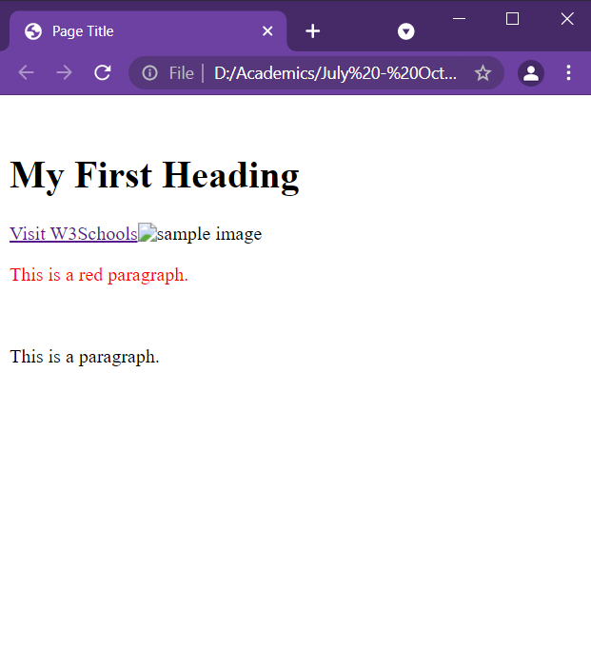
HTML Attributes
<!DOCTYPE html> <html lang = "en-US"> <head> <title>Page Title</title> </head> <body> <h1>My First Heading</h1>
<a href="https://www.w3schools.com">Visit W3Schools</a>
<img src="img_girl.jpg“ width="500" height="600“ alt=“Sample Image">
<p style="color:red;">This is a red paragraph.</p>
<p title="I'm a tooltip">This is a paragraph.</p>
</body> </html>

Slide 22
HTML Headings
HTML headings are titles or subtitles that to be displayed on a webpage.
Search engines use the headings to index the structure and content of your web pages.
Users often skim a page by its headings.
It is important to use headings to show the document structure.
<h1> headings should be used for main headings, followed by <h2> headings, then the less important <h3>, and so on.
Each HTML heading has a default size.
The size of any heading can be specified with the style attribute,
The font-size property of CSS can be used
<!DOCTYPE html> <html lang = "en-US"> <head> <title>Heading</title> </head> <body>
<h1>Heading 1</h1> <h2>Heading 2</h2> <h3>Heading 3</h3> <h4>Heading 4</h4> <h5>Heading 5</h5> <h6>Heading 6</h6>
<h1 style="font-size:60px;">Heading 1</h1>
</body>
</html>

Slide 23
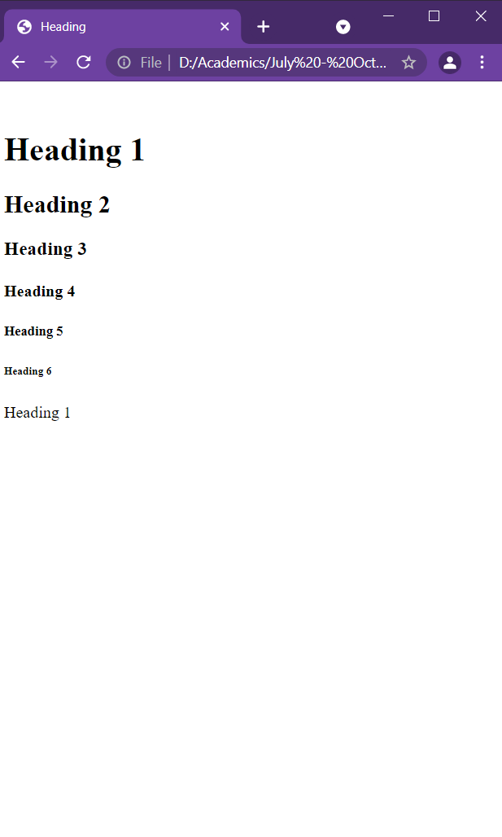
HTML Headings
<!DOCTYPE html> <html lang = "en-US"> <head> <title>Heading</title> </head> <body>
<h1>Heading 1</h1> <h2>Heading 2</h2> <h3>Heading 3</h3> <h4>Heading 4</h4> <h5>Heading 5</h5> <h6>Heading 6</h6>
<h1 style="font-size:60px;">Heading 1</h1>
</body>
</html>

Slide 24
HTML Paragraph
A paragraph always starts on a new line, and is usually a block of text.
The HTML <p> element defines a paragraph.
Browsers automatically add some white space (a margin) before and after a paragraph.
Note:
It is not sure how HTML will be displayed.
Large or small screens, and resized windows will create different results.
In HTML, display can’t be changed by adding extra spaces or extra lines in HTML code.
The browser will automatically remove any extra spaces and lines when the page is displayed:
<!DOCTYPE html> <html lang = "en-US"> <head> <title>Paragraph</title> </head> <body>
<p> This paragraph contains a lot of lines in the source code, but the browser ignores it. </p> <p> This paragraph contains a lot of spaces in the source code, but the browser ignores it. </p>
</body>
</html>

Slide 25
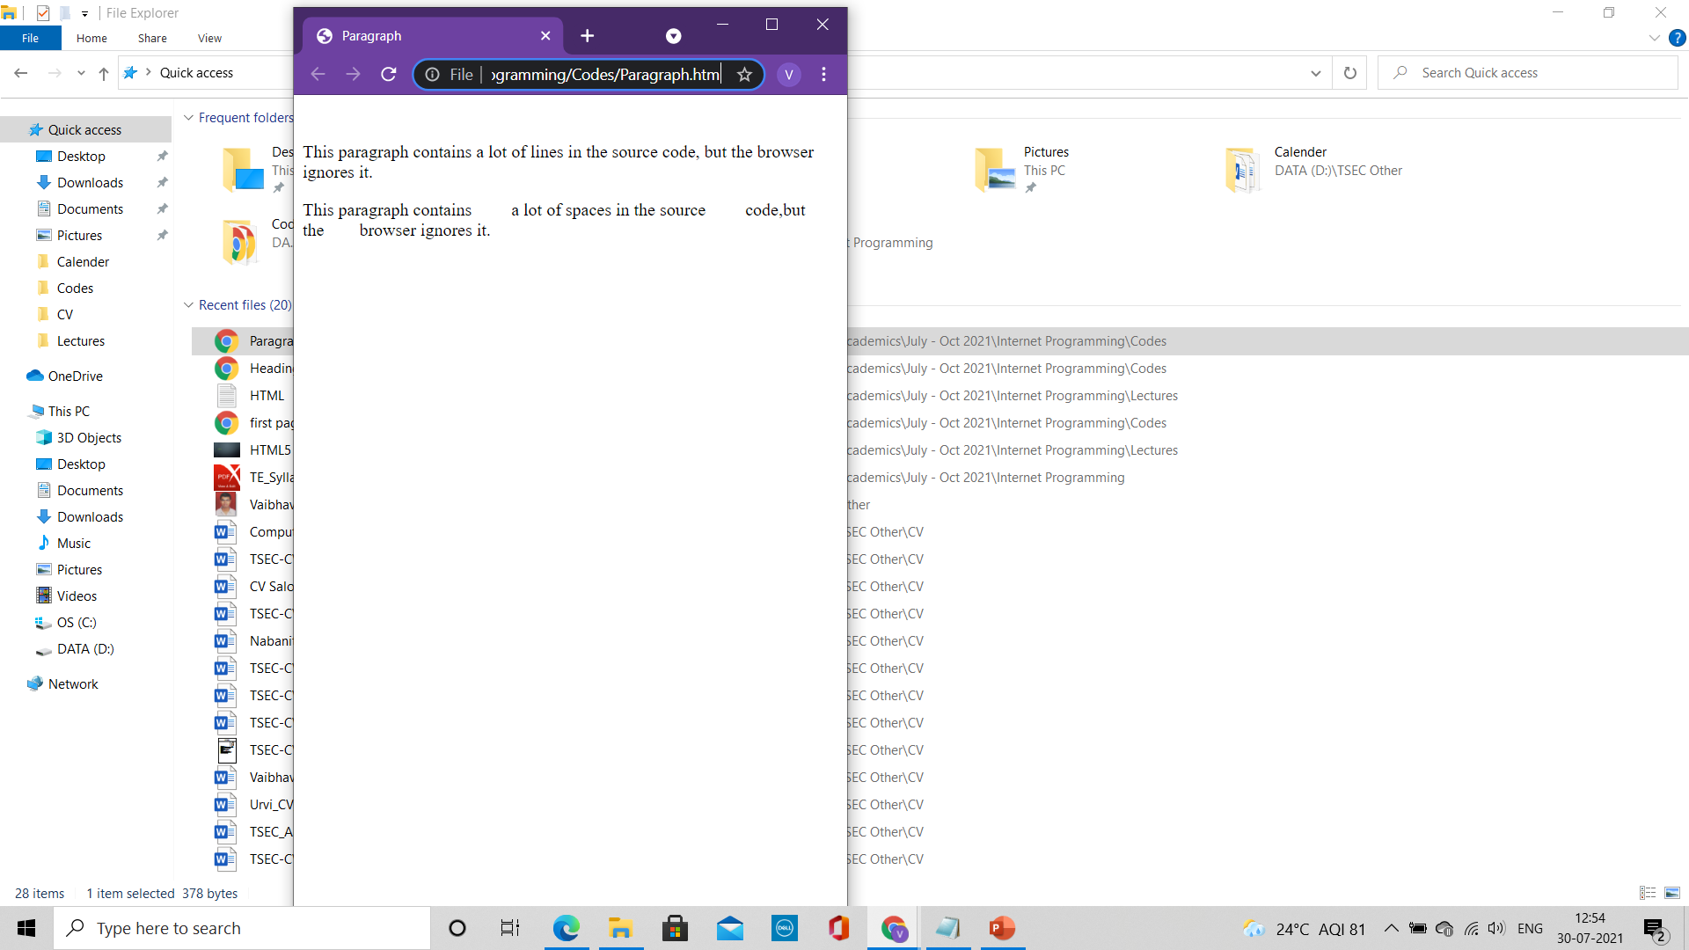
HTML Paragraph
<!DOCTYPE html> <html lang = "en-US"> <head> <title>Paragraph</title> </head> <body>
<p> This paragraph contains a lot of lines in the source code, but the browser ignores it. </p> <p> This paragraph contains a lot of spaces in the source code, but the browser ignores it. </p>
</body>
</html>

Slide 26
HTML Paragraph
HTML Horizontal Rule
The <hr> tag defines a thematic break in an HTML page,
It is most often displayed as a horizontal rule.
The <hr> element is used to separate content (or define a change) in an HTML page
HTML Line Breaks
The HTML <br> element defines a line break.
Use <br> tag to make a line break (a new line) without starting a new paragraph
The <br> tag is an empty tag
<!DOCTYPE html> <html lang = "en-US"> <head> <title>Paragraph1</title> </head> <body>
<h1>This is heading 1</h1> <p>This is some text.</p> <hr>
<h2>This is heading 2</h2> <p>This is some other text.</p> <hr>
<p>This is<br>a paragraph<br>with line breaks.</p>
</body>
</html>

Slide 27
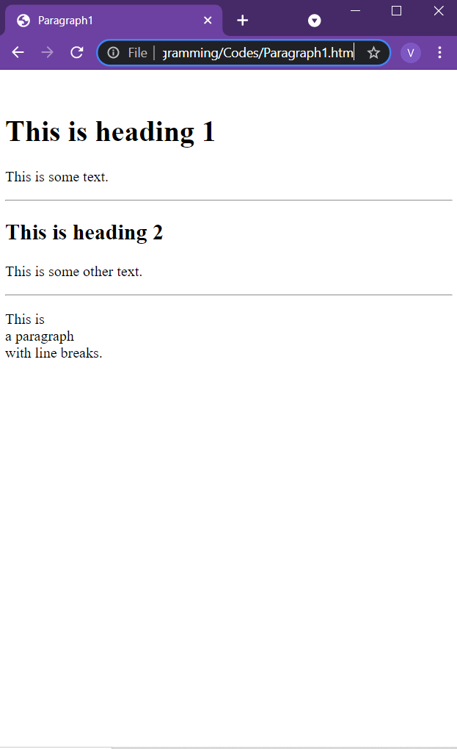
HTML Paragraph
<!DOCTYPE html> <html lang = "en-US"> <head> <title>Paragraph1</title> </head> <body>
<h1>This is heading 1</h1> <p>This is some text.</p> <hr>
<h2>This is heading 2</h2> <p>This is some other text.</p> <hr>
<p>This is<br>a paragraph<br>with line breaks.</p>
</body>
</html>

Slide 28
HTML Paragraph
<!DOCTYPE html> <html lang = "en-US"> <head> <title>Paragraph2</title> </head> <body>
<pre> My Bonnie lies over the ocean. My Bonnie lies over the sea. My Bonnie lies over the ocean. Oh, bring back my Bonnie to me. </pre>
</body>
</html>
HTML <pre> element
The HTML <pre> element defines preformatted text.
The text inside a <pre> element is displayed in a fixed-width font (usually Courier),
It preserves both spaces and line breaks:

Slide 29
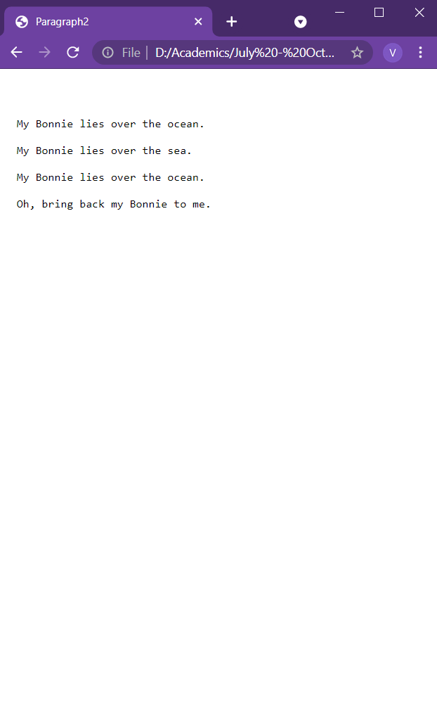
HTML Paragraph
<!DOCTYPE html> <html lang = "en-US"> <head> <title>Paragraph2</title> </head> <body>
<pre> My Bonnie lies over the ocean. My Bonnie lies over the sea. My Bonnie lies over the ocean. Oh, bring back my Bonnie to me. </pre>
</body>
</html>

Slide 30
HTML Styles
The HTML style attribute is used to add styles to an element, such as color, font, size, and more.
Setting the style of an HTML element, can be done with the style attribute.
The HTML style attribute has the following syntax:
<tagname style="property:value;">
The property is a CSS property.
The value is a CSS value.
Properties:
Background Colour
The CSS background-color property defines the background color for an HTML element.
2. Text Color
The CSS color property defines the text color for an HTML element
<!DOCTYPE html> <html lang = "en-US"> <head> <title>Style 1</title> </head> <body style= "background-color:orange;">
<h1 style="background-color:powderblue;">This is a heading</h1> <p style="background-color:tomato;">This is a paragraph.</p>
<h1 style="color:blue;">This is a heading</h1> <p style="color:red;">This is a paragraph.</p>
</body>
</html>

Slide 31
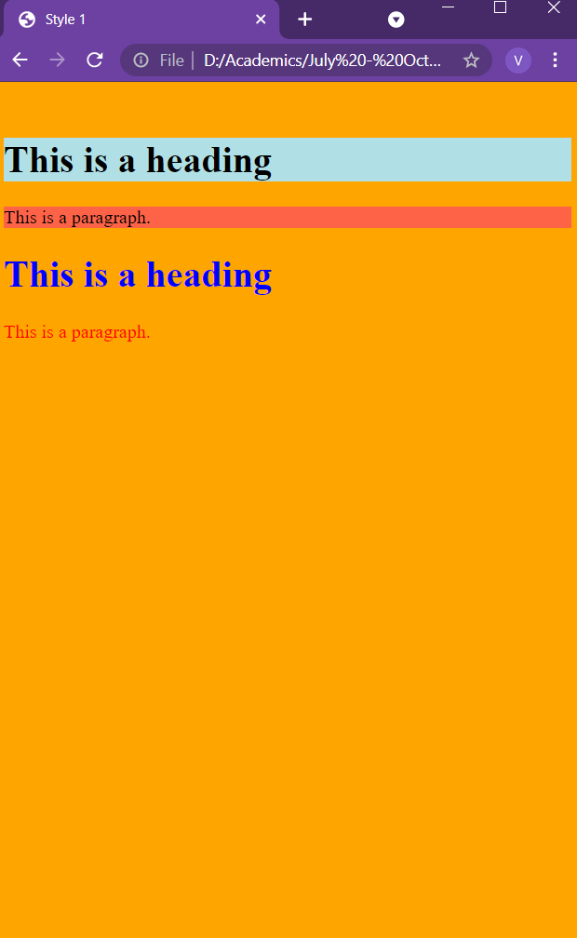
HTML Styles
<!DOCTYPE html> <html lang = "en-US"> <head> <title>Style 1</title> </head> <body style= "background-color:orange;">
<h1 style="background-color:powderblue;">This is a heading</h1> <p style="background-color:tomato;">This is a paragraph.</p>
<h1 style="color:blue;">This is a heading</h1> <p style="color:red;">This is a paragraph.</p>
</body>
</html>

Slide 32
HTML Styles
<!DOCTYPE html> <html lang = "en-US"> <head> <title>Style 2</title> </head> <body>
<h1 style="font-family:verdana;">This is a heading</h1> <p style="font-family:courier;">This is a paragraph.</p>
<h1 style="font-size:300%;">This is a heading</h1> <p style="font-size:160%;">This is a paragraph.</p>
<h1 style="text-align:center;">Centered Heading</h1> <p style="text-align:center;">Centered paragraph.</p>
</body>
</html>
Properties:
3. Font
The CSS font-family property defines the font to be used for an HTML element
4. Text size
The CSS font-size property defines the text size for an HTML element
5. Text Alignment
The CSS text-align property defines the horizontal text alignment for an HTML element

Slide 33
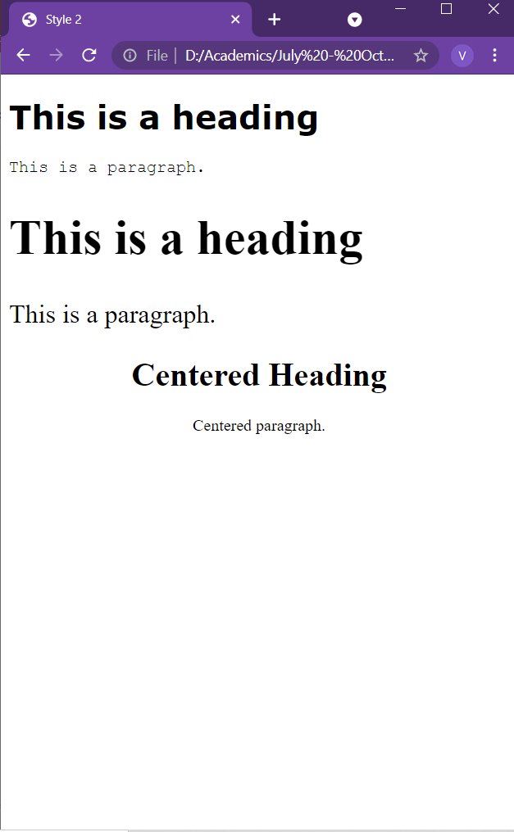
HTML Styles
<!DOCTYPE html> <html lang = "en-US"> <head> <title>Style 2</title> </head> <body>
<h1 style="font-family:verdana;">This is a heading</h1> <p style="font-family:courier;">This is a paragraph.</p>
<h1 style="font-size:300%;">This is a heading</h1> <p style="font-size:160%;">This is a paragraph.</p>
<h1 style="text-align:center;">Centered Heading</h1> <p style="text-align:center;">Centered paragraph.</p>
</body>
</html>

Slide 34
HTML Formatting Elements
HTML <b> Element
It defines bold text, without any extra importance
The HTML <strong> element
It defines text with strong importance.
The content inside is typically displayed in bold.
The HTML <i> element
It defines a part of text in an alternate voice or mood.
The content inside is typically displayed in italic.
The <i> tag is often used to indicate a technical term, a phrase from another language, a thought, a ship name, etc.
The HTML <em> element
It defines emphasized text.
The content inside is typically displayed in italic.
A screen reader will pronounce the words in <em> with an emphasis, using verbal stress.
<!DOCTYPE html> <html lang = "en-US"> <head> <title>Formatting</title> </head> <body>
<p><b>This text is bold</b></p>
<p><strong>This text is important!</strong></p>
<p><i>This text is italic</i></p>
<p><em>This text is emphasized</em></p>
</body>
</html>

Slide 35
HTML Formatting Elements
HTML <small> Element
It defines smaller text
HTML <mark> Element
It defines text that should be marked or highlighted
The HTML <del> element
It defines text that has been deleted from a document.
Browsers will usually strike a line through deleted text
HTML <ins> Element
It defines a text that has been inserted into a document.
Browsers will usually underline inserted text:
<!DOCTYPE html> <html lang = "en-US"> <head> <title>Paragraph</title> </head> <body>
<p><b>This text is bold</b></p>
<p><strong>This text is important!</strong></p>
<p><i>This text is italic</i></p>
<p><em>This text is emphasized</em></p>
<p><small>This is some smaller text.</small></p>
<p>Do not forget to buy <mark>milk</mark> today.</p>
<p>My favorite color is <del>blue</del> <ins>red</ins>.</p>
</body>
</html>

Slide 36
HTML Formatting Elements
<!DOCTYPE html> <html lang = "en-US"> <head> <title>Paragraph</title> </head> <body>
<p><b>This text is bold</b></p>
<p><strong>This text is important!</strong></p>
<p><i>This text is italic</i></p>
<p><em>This text is emphasized</em></p>
<p><small>This is some smaller text.</small></p>
<p>Do not forget to buy <mark>milk</mark> today.</p>
<p>My favorite color is <del>blue</del> <ins>red</ins>.</p>
<p>This is <sub>subscripted</sub> text.</p>
<p>This is <sup>superscripted</sup> text.</p>
</body>
</html>
The HTML <sub> element
It defines subscript text.
Subscript text appears half a character below the normal line, and is sometimes rendered in a smaller font.
Subscript text can be used for chemical formulas, like H₂O
The HTML <sup> element
It defines superscript text.
Superscript text appears half a character above the normal line, and is sometimes rendered in a smaller font.
Superscript text can be used for footnotes, like WWW^{[1]}

Slide 37
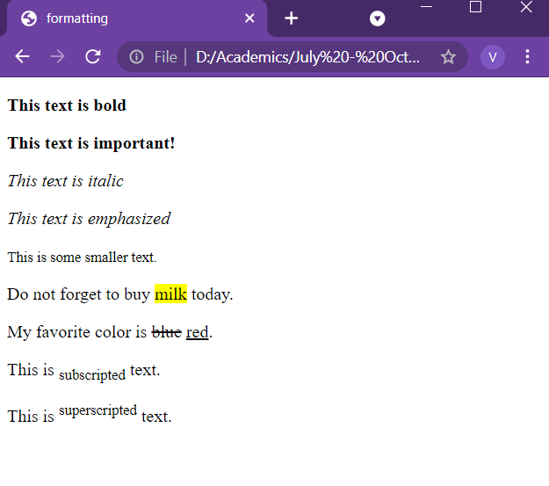
HTML Formatting Elements
<!DOCTYPE html> <html lang = "en-US"> <head> <title>Paragraph</title> </head> <body>
<p><b>This text is bold</b></p>
<p><strong>This text is important!</strong></p>
<p><i>This text is italic</i></p>
<p><em>This text is emphasized</em></p>
<p><small>This is some smaller text.</small></p>
<p>Do not forget to buy <mark>milk</mark> today.</p>
<p>My favorite color is <del>blue</del> <ins>red</ins>.</p>
<p>This is <sub>subscripted</sub> text.</p>
<p>This is <sup>superscripted</sup> text.</p>
</body>
</html>

